Slide 1

DWS - Industry Integrated Skilling Program
Prepared by
Thousif

Slide 2
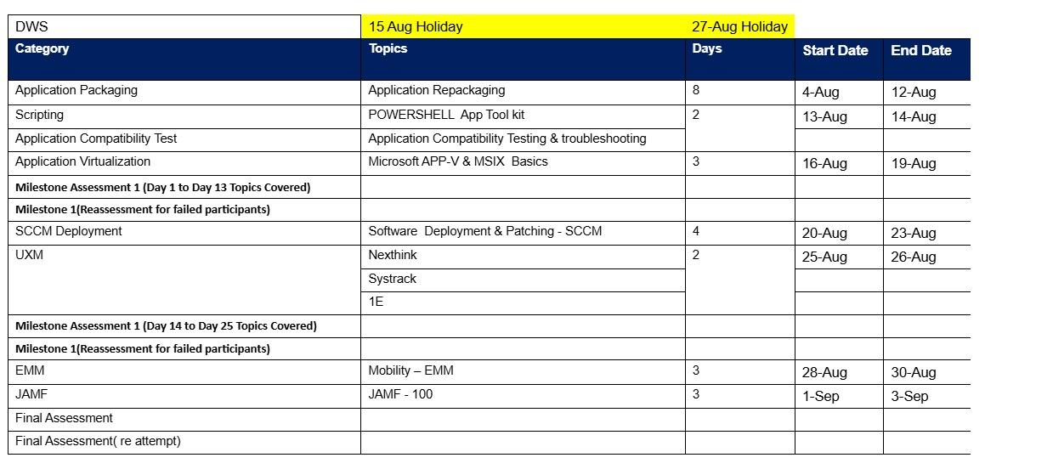
Program Dates

Slide 3
Program Schedule
8 hour per day
8:45 am – Session starts
15 mts Short break ( 11am – 11.15am)
60 mts Lunch break ( 1pm – 2.00pm)
15 mts Short break ( 4pm – 4.15pm)
5:15 pm Recap, Q&A, Feedback & Closing the day

Slide 4
Candidate guidelines
Be on-time
Ask questions if you have doubts or need clarification
Perform your Lab Activities without fail
Respect break times
Mobile phones in Silent mode
MCQ / Lab Assessment at the end of modules
Contact Trainer for any training or lab related issues

Slide 5
DWS Training

Slide 6
Training Module
Module 1 – Introduction to Windows Operating System

Slide 7
Introduction To Windows Operating System
Introduction to Operating System - An operating system (OS) is system software that manages computer hardware, software resources, and provides common services for computer programs.
Operating System Vendors –
Windows - Microsoft Windows – Wikipedia
Apple iOS
Android
Ubuntu
Linux

Slide 8
Introduction To Windows Operating System
Operating Systems Type
Client
Windows 10
Windows 11
2. Server
Windows Server 2016
Windows Server 2019
Windows Server 2022

Slide 9
Introduction To Windows Operating System
Operating Systems Version History
Client - Windows 10 - release information | Microsoft Learn
Server - Windows Server release information | Microsoft Learn

Slide 10
Introduction To Windows Operating System
Windows Operating System LifeCycle
  Supported versions of Windows client | Microsoft Learn
  Windows Server release information | Microsoft Learn

Slide 11
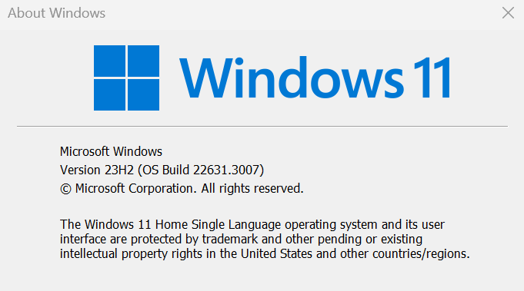
Introduction To Windows Operating System
Identifying Windows Build Version and Edition

Slide 12
Introduction To Windows Operating System
  Windows Basic Functions
  Start Menu
  Task Bar
  Command Prompt and PowerShell
  Universal App – Office
  File/Windows Explorer
  Inbuilt Apps – Edge
  MS Store

Slide 13
Introduction To Windows Operating System
  Windows Basic Functions
  Event viewer
  Windows Run
  UAC -Admin, Standard
  Windows Registry
  Disk Cleaner
  Disk Management
  Task Scheduler

Slide 14
Training Module
Module 2 – Application Packaging

Slide 15
Introduction To Application Packaging
Application Packaging - is the process of preparing software applications for deployment in a standardized, automated, and manageable way across multiple systems or environments. It’s especially crucial in enterprise IT environments where consistency, security, and scalability are key.
Their terms application packaging and repackaging is mostly used in the same sense. However, if we get the binaries from a vendor, then we combine them to make an application package. If we get a legacy installer from a vendor such as an exe or msi or batch files etc then we customize them as an application repackage.

Slide 16
Introduction To Application Packaging
Application packaging typically includes:
Customization: Tailoring the application settings to meet organizational needs (e.g., disabling auto-updates, setting default paths).
Bundling: Wrapping all necessary files, configurations, and dependencies into a single package.
Testing: Ensuring the package installs, runs, and uninstalls correctly without conflicts.
Deployment Readiness: Making the package compatible with deployment tools like SCCM, Intune, or other endpoint management systems.

Slide 17
Introduction To Application Packaging
Why Standard App Packaging is necessary in IT ?
Consistency: Ensures all users get the same version and configuration.
Efficiency: Speeds up deployment and reduces manual errors.
Security: Helps enforce policies and reduce vulnerabilities.
Scalability: Supports mass deployment across thousands of devices.

Slide 18
Device Driver Management
Device drivers are low-level software components that allow the operating system to communicate with hardware devices like printers, graphics cards, network adapters, etc.
They act as translators between the OS and the hardware.
Each device requires a specific driver to function properly.
Handling Drivers Within MSI Packages: MSI (Microsoft Installer) is a Windows installation package format used to install software, including drivers.
How Drivers Are Packaged in MSI:
MSI files can include drivers directly or call external driver installers.
Driver installation may be handled using:
DPInst.exe (Driver Package Installer)
PnPUtil.exe (Plug and Play Utility)

Slide 19
Device Driver Management
Driver-related files and where they go after installation:
After installation, drivers are staged in the DriverStore:
Location: C:\Windows\System32\DriverStore\FileRepository &
C:\Windows\inf
File Type | Description | Common Location
.inf | Driver setup info | Inside MSI or %SystemRoot%\INF
.sys | Driver binary | %SystemRoot%\System32\drivers
.cat | Catalog file for signing | %SystemRoot%\System32\CatRoot
.dll | Driver support libraries | %SystemRoot%\System32
.exe | Installer or helper tools | May be in MSI or %ProgramFiles%

Slide 20
Device Driver Management
Logs for Successful Installation
MSI Installation Logs: Enable logging with this command:
msiexec /i yourdriver.msi /L*v install.log
Event Viewer: Event Viewer → Windows Logs → System
Filter for source: DriverFrameworks-UserMode, Service Control Manager, or SetupAPI
Device Manager: Right-click device → Properties → Driver tab
Check driver version and provider
PnPUtil: pnputil /enum-drivers

Slide 21
Device Driver Management
Kernel Drivers? - Kernel drivers operate in Ring 0, the most privileged level of the operating system. They directly interact with hardware and core OS functions.
Examples of Kernel Drivers:
File system drivers (e.g., ntfs.sys)
Network drivers (e.g., ndis.sys)
Storage drivers (e.g., storport.sys)
Security drivers (e.g., antivirus kernel hooks)

Slide 22
Device Driver Management
Identifying Kernel Drivers
Windows Device Manager: View driver details under device properties → Driver tab → Driver File Details
Kernel drivers typically reside in C:\Windows\System32\drivers
DriverQuery Command: driverquery /v /fo list

Slide 23
Device Driver Management
Handling Kernel Drivers Within MSI:
MSI packages can install kernel-mode drivers, but they must follow strict guidelines due to their privileged nature.
Key Considerations:
Driver Signing: Kernel drivers must be signed (WHQL or EV certificate) to load on modern Windows.
INF File: Defines how the driver is installed and associated with hardware.

Slide 24
Handling Services
Handling Windows Services in MSI: Windows Services are background processes that can be installed and managed via MSI using built-in tables and actions.
Key MSI Tables for Services:
Table Name | Purpose
ServiceInstall | Defines service properties (name, startup type, dependencies)
ServiceControl | Controls service actions (start, stop, delete) during install/uninstall
MsiServiceConfig | Advanced service configuration (e.g., delayed start, failure actions)
MsiServiceConfigFailureActions | Specifies actions on service failure

Slide 25
Handling Services
Handling Printers in MSI: MSI can also manage printer installation, driver deployment, and port configuration.
Printer Deployment Actions:
Action Type | Description
Printer | Create, modify, or delete printers
Printer Driver | Install or remove printer drivers
Printer Port | Create/delete local or TCP/IP ports
Print Processor | Add/remove print processors
Print Monitor | Add/remove language or port monitors

Slide 26
GUID String and Log locations
64-bit: HKLM\Software\Microsoft\Windows\CurrentVersion\Uninstall\{GUID}
32-bit apps on 64-bit OS: HKLM\Software\WOW6432Node\Microsoft\Windows\CurrentVersion\Uninstall\{GUID}
System App:
64-bit: C:\Program Files\<AppName>\Logs\...
32-bit: C:\Program Files (x86)\<AppName>\Logs\...
Per-user apps logs:
C:\Users\<UserName>\AppData\Local\<AppName>\Logs\
C:\Users\<UserName>\AppData\Roaming\<AppName>\Logs\

Slide 27
Windows Batch Script
Batch Script (for Chrome or Edge)
@echo off
start chrome "https://www.example.com"
:: or use Edge
:: start msedge "https://www.example.com"
Save this as open_browser.bat
Place it in: C:\Scripts\open_browser.bat

Slide 28
MS 365 Packaging
Microsoft Office Architecture – Microsoft Office (now part of Microsoft 365 Apps) is designed with a modular, service-connected architecture that supports flexible packaging and deployment across enterprise environments.
Packaging Model | Description | Status
Click-to-Run (C2R) | Streaming-based installer using Office Deployment Tool (ODT) | ✅ Primary method
MSI (Windows Installer) | Traditional installer used in older Office versions (Office 2016 and earlier) | ❌ Deprecated
MSIX | Modern packaging format for Windows apps | 🔄 In development for Office apps

Slide 29
MS 365 Packaging
When Microsoft 365 Apps are installed via Click-to-Run, the system registers a single unified entry in the Add/Remove Programs list:
Display Name: Microsoft 365 Apps for enterprise or Microsoft Office 365 ProPlus
Publisher: Microsoft Corporation
Version: Reflects the build number (e.g., 16.0.XXXX.XXXX)
Size: Varies depending on installed components
Install Location: Usually under C:\Program Files\Microsoft Office
It’s a container for all Office apps (Word, Excel, PowerPoint, Outlook, etc.)
You cannot uninstall individual apps from this entry unless installed separately
The entry is tied to the Click-to-Run virtualization layer, not traditional MSI
If you’ve excluded apps during deployment (e.g., Access or Publisher), they won’t appear in the Start Menu or be usable—but the Add/Remove entry still shows the full suite name
Registry Location for Program Entry: HKEY_LOCAL_MACHINE\SOFTWARE\Microsoft\Windows\CurrentVersion\Uninstall
Look for keys with DisplayName like Microsoft 365 Apps

Slide 30
Application Installation Type
Context | Runs As | Access Level | Best For | Limitations
User | Logged-in user | Limited | Profile-based apps, Store apps | No system access
Admin | Elevated user (FedEX App Manager) | Full (via UAC) | Manual installs, troubleshooting | Requires user consent
System | SYSTEM account | Full (silent) | Enterprise deployments, Intune | No user interaction, no profile data

Slide 31
User Context Installation
MSI is Compatible for User Context -> Open the .msi and check the Property table:
If ALLUSERS=1, it's a machine-wide install
If ALLUSERS=2 or missing → can be user-level
Verify Installation Location:
Context App Installs To
Per-user - C:\Users\USERNAME\AppData\Local\Programs\
Per-machine -> C:\Program Files\ or “C:\Program Files (x86)”

Slide 32
Active Setup Versioning
Active Setup is a Windows mechanism that allows you to run a command once per user at logon. It’s commonly used to initialize user-specific settings after an application is installed.
It compares registry entries in HKLM and HKCU. If the user’s profile doesn’t have the matching entry, the command is executed.
Registry Structure
Machine Key (HKLM)
reg: HKLM\SOFTWARE\Microsoft\Active Setup\Installed Components\{YourAppGUID}
User Key (HKCU)
reg: HKCU\SOFTWARE\Microsoft\Active Setup\Installed Components\{YourAppGUID}
When a user logs in, Windows checks if the Version in HKCU matches HKLM. If not, it runs the command in StubPath.

Slide 33
Win 10 vs Win 11 – App Packaging
Feature Area | Windows 11 | Windows 10
User Interface | Fluent Design, centered Start Menu & Taskbar | Classic Start Menu & Taskbar
System Requirements | TPM 2.0, Secure Boot, UEFI, 64-bit only | More lenient; supports older hardware
Microsoft Store | Redesigned, supports Android apps via WSA | Traditional Store, no Android support
Packaging Format | Strong push for MSIX adoption | Supports MSI, EXE, and MSIX
Security Model | Enforced hardware-based security (TPM, VBS) | Software-based security still common
AppContainer Support | Enhanced isolation for packaged apps | Supported but less emphasized
Virtual Desktops | Snap Layouts, improved multitasking | Basic virtual desktop support
Copilot Integration | Built-in AI assistant for productivity | No native AI assistant

Slide 34
Win 10 vs Win 11 – App Packaging
MSIX Adoption
Windows 11 encourages MSIX for modern deployment, offering:
Clean install/uninstall
Auto-updates
App identity for accessing OS features (e.g., notifications, background tasks)
Windows 10 supports MSIX but is more tolerant of legacy formats like MSI and EXE.
Compatibility
Windows 11 has stricter hardware requirements (TPM 2.0, Secure Boot), which may affect legacy app deployment.
Windows 10 is more forgiving, making it a better target for older enterprise environments.

Slide 35
Windows Troubleshooting and Debugging
These are commonly used for system diagnostics, troubleshooting:
LogonSessions
Purpose: Displays information about logged-on users.
Usage: Shows detailed information about each logon session including user name, logon time, and authentication package.
Common Command: LogonSessions.exe
Autologon
Purpose: Configures Windows to log on automatically to a specific account.
Usage: Stores encrypted credentials in the registry to bypass manual login.
GUI Tool: Simple interface to input username, password, and domain.

Slide 36
Windows Troubleshooting and Debugging
Process Explorer
Purpose: Advanced version of Task Manager; shows real-time information on running processes.
Features:
DLL and handle view
Process tree visualization
PsExec
Purpose: Execute processes on remote systems.
Usage: Great for remote administration and executing commands interactively or in background.
Example: Command: PsExec \\RemotePC cmd

Slide 37
Windows Troubleshooting and Debugging
PsTools
Contains:
PsExec – execute processes remotely
PsList – list detailed process stats
PsKill – kill processes by name or ID
PsService – view and control services
PsShutdown – shutdown/reboot system
Use Case: Remote administration without RDP

Slide 38
Windows Troubleshooting and Debugging
RegMon (Deprecated - replaced by Process Monitor)
Replacement: Now integrated into Process Monitor, which combines RegMon and FileMon features.
Use Case: Troubleshooting apps that access or modify the Windows registry.
Whois
Tool Type: Domain information lookup
Purpose: Queries the WHOIS database for domain ownership, registration, and contact information.

Slide 39
Vulnerability Management
Vulnerability Management: It's a continuous cycle that ensures applications remain secure throughout their lifecycle. It involves:
Discovery
Scanning applications for known vulnerabilities.
Identifying outdated libraries, insecure configurations, or exposed endpoints.
Assessment
Evaluating the severity of each vulnerability (e.g., using CVSS scores).
Determining the risk based on exploitability and impact.
Prioritization
Ranking vulnerabilities by urgency.
Focusing on those with high risk or active exploits.

Slide 40
Vulnerability Management
Remediation
Applying patches or updates.
Rewriting insecure code or changing configurations.
Verification
Re-testing to confirm the fix worked.
Ensuring no new issues were introduced.
Reporting & Monitoring
Keeping logs and dashboards for audit and compliance.
Continuously monitoring for new threats.
Tools like - Qualys , Rapid7, ManageEngine

Slide 41
Lab Tasks
Tasks: Vulnerability Remediation
Identify unused local admin user and disable.
Remove Bulk versions of apps via PS and Batch file scripts.
Remove files, folder, registry via script

Slide 42
Build Complex Package and TS App
Task Sequence to install multiple Application in a sequence during build.
Package Complex app using Tool like Advance Installer

Slide 43
Introduction To Packaging Tools
ORCA - https://developer.microsoft.com/en-us/windows/downloads/windows-sdk/
2) Advance Installer - https://www.advancedinstaller.com/

Slide 44
ORCA
Orca is a database editor for Windows Installer (MSI) files, and it’s part of the Windows Installer SDK.
It provides a GUI for editing MSI files directly and allows users to make low-level changes to the database structure that underlies the MSI installation process.
Creating and editing MSI files: Orca is often used to modify and customize MSI installation packages.
Debugging installations: Orca can be used to diagnose issues in an MSI file. For example, if an installer fails to properly register a file or create a directory, Orca allows you to check the installation database for errors.
Example:
Let’s say you have an MSI package, but you need to modify the registry entries that the installation creates. You can open the MSI file in Orca, go to the Registry table, and change or add the required registry keys.

Slide 45
Advance Installer
Advanced Installer is a powerful and user-friendly tool for creating, editing, and managing Windows installation packages (MSI and EXE). It offers a more accessible approach compared to Orca for those who may not be as comfortable working with low-level database editing. It provides a variety of templates and wizards that guide users through the process.
Creating MSI/EXE installers: Advanced Installer is commonly used to create installation packages from scratch, including the installation of software, dependencies, custom actions, and registry entries.
Custom actions and dialogs: You can add custom dialogs, user inputs, or advanced installation logic (e.g., checking if a specific version of .NET Framework is installed).
Example: Suppose you want to distribute a .NET application along with its dependencies, such as specific versions of the .NET Framework. In Advanced Installer, you can create a setup package that checks if the required version is installed and prompts the user to install it if it's missing. You can also package the application into a single EXE installer for simplicity.

